Slide 1
Welcome To The year one information meeting
Notes:
sarah

Slide 2
Learning
Topic overview
Trips
Homework
Website signposting
Communication
Notes:
sarah

Slide 3
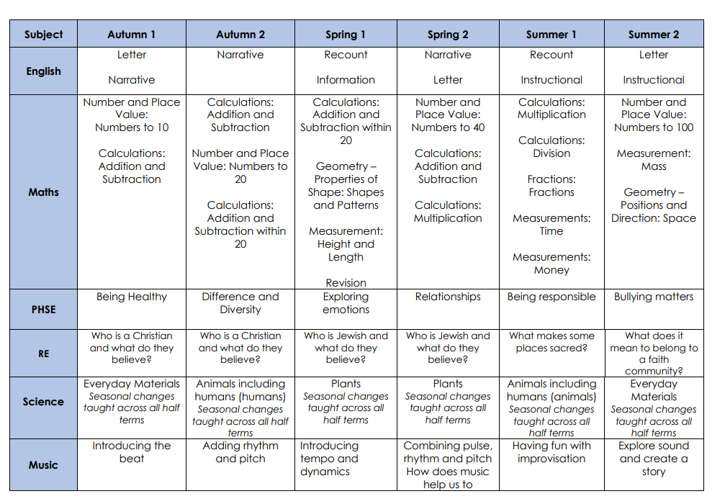
Topic overview
https://www.dale.derby.sch.uk/curriculum-home
Notes:
Sarah

Slide 4
Trips and Visitors In year one
Derby Museum – Florence Nightingale workshop (tbc)
Yorkshire Wildlife Park – Paws, Claws and Whiskers
Local church
Information about trips will be sent out several weeks before they occur, and medical forms / payments completed through Parentpay.
Notes:
Tim

Slide 5
Homework
Maths – Short fluency or arithmetic tasks, such as quick fire number recognition, counting forwards and backwards to 10 and then 20, numbers that go together to make 10 etc
Reading - Daily reading with your child using the Collins ebooks. These details can be found in the front of your child’s reading journal. A library book will also be sent home weekly that you can enjoy sharing together, to help develop a love of reading.
Notes:
teachers

Slide 6
Homework
Notes:
teachers

Slide 7
phonics
Phonics continues into Year 1 still following the Little Wandle Scheme.
Phonics lessons starts at 9am every morning, therefore arriving promptly is extremely important!
Phonics — Dale Community Primary School
Notes:
Sarah

Slide 8
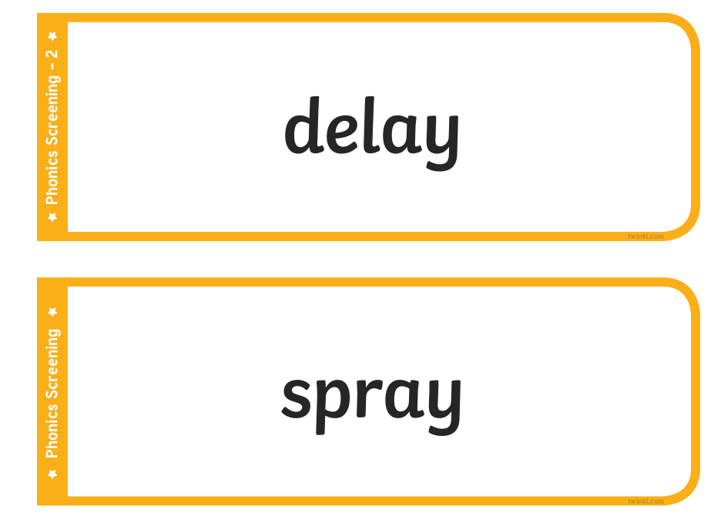
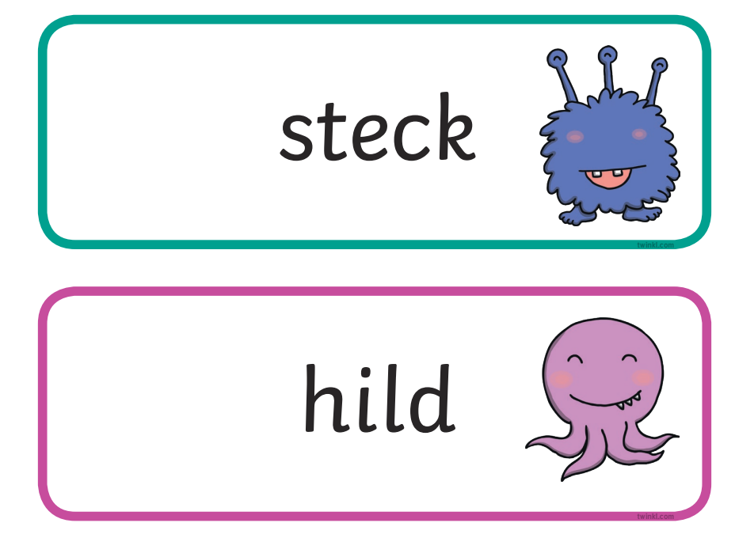
Phonics screening check
Year 1 children will be taking the Phonics Screening Check in June 2024. They will read real words and pseudo words.
Notes:
Sarah

Slide 9
Website Signposting
https://www.dale.derby.sch.uk/
Notes:
sarah

Slide 10
Food at dale
Children will continue to receive a free school meal, and there will be a choice between a hot and cold meal each morning. Menus are available on our school website or a paper copy at the office.
A healthy snack and milk is provided in Year One. Snack money is payable on ParentPay at £33/Year or £11/term
Notes:
Kira

Slide 11
Communication
A member of the Leadership team on the school gates at the beginning and end of the school day
Classroom Teachers available for a quick message when dismissing children at the end of the day once the rest of the children have gone, or to arrange a convenient time for a longer conversation
Call the office to arrange a meeting with the class teacher if a longer conversation is needed
Notes:
sarah

Slide 12
Expectations and Behaviour
The School Day
School Rules
Rewards/ Consequences
Attendance
School Uniform
Notes:
sarah

Slide 13
The School Day
The school day begins at 8.40 - Learning begins in classrooms at 8.40
Register closes at 9am and formal lessons begin
Arrival after 9am- recorded as ‘Late’ and will impact overall attendance
Notes:
sarah

Slide 14
School Rules
The three school rules are displayed in every classroom and around the building. These are:
• Ready
(All children should be ready to learn)
• Respect
(All children should show respect for everyone and everything)
• Safe
(All children should keep themselves and others safe)
At the start of each year, each class will discuss and agree what Ready, Respect, Safe means for their class using age appropriate language and concepts.
This policy will also be adhered to outside of school and the same high standards of behaviour will be expected e.g. walking to the park, on residential visits, school trips and at events.
Notes:
Sarah
The school rules are outlined in the Behaviour policy. They are referred to throughout the school day- used as a common language so that children are familiar with them and their importance. Teachers discuss each rule and explicitly encourage children to think about what each looks like- in the classroom, on the playground, walking through school, on a trip- in every situation. Also- what doesn’t each rule look like in those situations- what should the teacher see/ what shouldn’t the teacher see.

Slide 15
rewards
Expectations of positive behaviour form the basis of our reward system
C
O
L
L
A
B
O
R
A
T
E
Notes:
Kira
Go through each one and explain how each reward works and why we have it- e.g. collaborate- to encourage chn to work together, be kind, respectful and co-operative

Slide 16
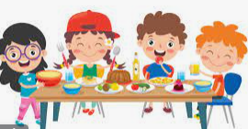
rewards
Good Work Assembly… Half Termly Book Prize…
In each class, 3 children are chosen and a book is given as a prize to reward:
Attendance
Kindness
Reading
Top Table…
Notes:
Tim
Explain each reward

Slide 17
Consequences
We focus on positive behaviour
If children are struggling we follow a clear system
Reminder
Warning
Last Chance
Time to Think
Repair
If children are given ‘Time to Think’ a consequence may also be given such as;
Missing playtime
Missing lunchtime
Phone calls home may also be made
Notes:
Kira

Slide 18
Attendance & rewards
“Data from 2019 shows that 84% of Key Stage 2 pupils who had 100% attendance achieved the expected standard, compared to 40% of pupils who were persistently absent across the key stage.”
“Being in school is important to your child’s achievement, wellbeing, and wider development. Evidence shows that the students with the highest attendance throughout their time in school gain the best GCSE and A Level results.
Our research found that pupils who performed better both at the end of primary and secondary school missed fewer days than those who didn’t perform as well.”
Department for education
Notes:
Sarah
Talk about the curriculum and progression- one year feeds into the next- if chn have lots of gaps in their learning they struggle to connect new learning.

Slide 19
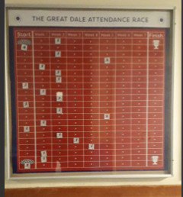
Attendance & rewards
Half termly cake for class who wins race
Weekly trophy for class with best attendance
School trip – bowling for excellent attendance
End of year improved attendance- shopping voucher for family
Notes:
Sarah

Slide 20
School & PE Uniform
School Uniform
School website
home page
parent info
school uniform
Notes:
Sarah
Click link (school uniform) to share web page with parents
Be clear that black school shoes must be worn- not black trainers
PE Uniform- PE uniform can be bought at reasonable prices from shops such as Asda, Sainsburys etc

Slide 21
Internet safety
Issues and Age Limits
Parental Controls and Advice

Slide 22
Issues and age limits
Increased number of friendship issues linked to time spent online
Children have access to APPs and online platforms beyond their age limit
Learning and teaching time is taken up dealing with these issues
Notes:
Sarah
Chn don’t always have the maturity to deal with the content

Slide 23
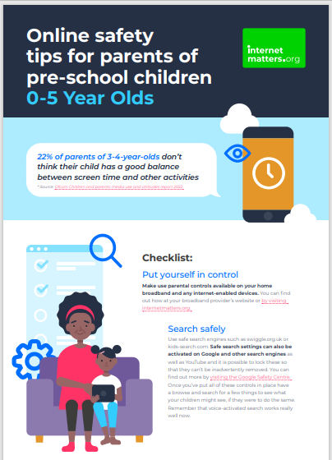
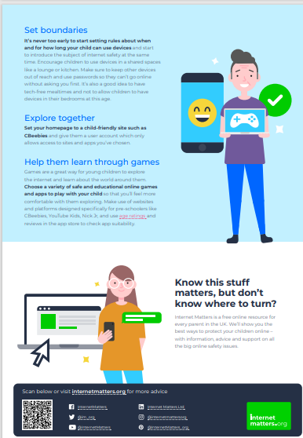
Parental Controls and advice
Take Control…
Internet Safety Guidance
Search Internet Matters
Young Children (6-10)
OR
0-5-year-olds
Online safety guide
0-5 years
Notes:
Sarah

